Slide 1

CSE 780: Design and Analysis of Algorithms
Lecture 16:
Graph Alg.
  DFS
  Topological sort
CSE 780 Algorithms

Slide 2
Breadth-first Search
    Works for both directed and undirected graph
    Starting from source node s, visits remaining nodes of graph from small distance to large distance
    Produce a BF-tree
    Return distance between s to any reachable node in time O(|V| + |E|)
CSE 780 Algorithms

Slide 3
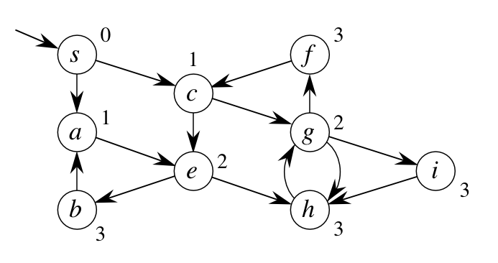
Depth-first Search
Breadth-first search:
  Go as broad as possible at each node
Depth-first search (a different strategy):
  Go as deep as possible first
CSE 780 Algorithms

Slide 4
More Formally
Again, a node
  white: unvisited
  gray: discovered but not finished
  black: finished (explored)
For every node v ∈ V
  d[v]: time v is discovered
  f[v]: time v is finished (all edges in v’s adjacency list are explored)
  f[v] - d[v] = time from grey to black
CSE 780 Algorithms

Slide 5
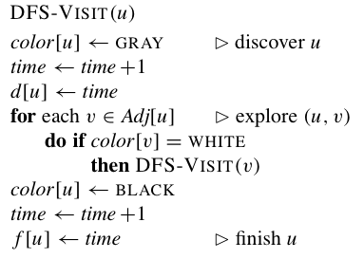
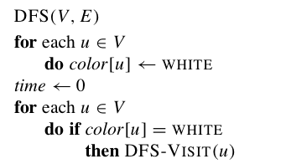
Pseudo-code
Time complexity
CSE 780 Algorithms

Slide 6
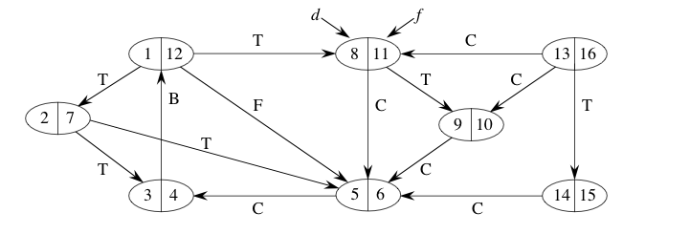
Example
CSE 780 Algorithms

Slide 7
Depth-first Forest
Consider all edges (p(u), u)
  When it happens: p(u) is grey, u is white
  A forest, called Depth-first forest
  Depends on the order of vertices
  Example from previous page
Property:
  Start (finish) time for each tree: same order as if we visit nodes in pre-order (post-order) tree walk
CSE 780 Algorithms

Slide 8
Properties of DFS
Parenthesis Theorem:
  Any two nodes u and v, one of the following 3 cases:
    (1) u is descendant of v, and d[v] < d[u] < f[u] < f[v]
    (2) v is descendant of u, and d[u] < d[v] < f[v] < f[u]
    (3) u is not descendant of v, neither is v a descendant of u, and
    d[u] < f[u] < d[v] < f[v] or d[v] < f[v] < d[u] < f[u]
  u is descendant of v iff d[v] < d[u] < f[u] < f[v]
White-path Theorem
  u is descendant of v iff at the time of d[v], there is a all white path from v to u.
CSE 780 Algorithms

Slide 9
Classification of Edges
Four types of an edge (u,v)
  Tree edge
  Non-tree edges:
    Back edge: u is descendant of v
    Forward edge: v is descendent of u
    Cross edge: others
  Distinguish by the color of v
Example
a
b
c
d
j
e
h
f
g
k
CSE 780 Algorithms

Slide 10
Theorem
In a DFS of an undirected graph G, every edge of G is either a tree edge or a back edge.
a
b
c
d
j
e
h
f
g
k
CSE 780 Algorithms

Slide 11
Connected Components
Undirected graph
  DF forests represents the set of connected components
Directed graph
  Does the tree rooted at u include all nodes accessible from u ?
CSE 780 Algorithms

Slide 12
Directed Acyclic Graph
DAG: directed acyclic graph
Determine whether a directed graph is DAG or not
  How?
A directed graph G is a dag iff a DFS of G yields
no back edges.
How about an undirected acyclic graph?
CSE 780 Algorithms

Slide 13
Topological Sort
A topological sort of a dag G = (V, E)
  A linear ordering A of all vertices from V
  If edge (u,v) ∈ E => A[u] < A[v]
undershorts
socks
watch
pants
shoes
shirt
belt
tie
jacket
CSE 780 Algorithms
Notes:
Partial order, total order, what if we have cycles?

Slide 14
Topological Sort
Using DFS
Topological-Sort(G)
  Call DFS(G) to compute finishing times f[v] for each v
  Output vertices in descreasing order of finishing time
Time complexity
  O (|V| + |E|)
CSE 780 Algorithms

Slide 15
Example
17, 18
11, 16
undershorts
socks
watch
12, 15
pants
shoes
9, 10
13, 14
shirt
1, 8
6, 7
belt
tie
2, 5
jacket
3, 4
socks , undershots , pants , shoes , watch , shirt , belt , tie , jacket
CSE 780 Algorithms

Slide 16
Correctness
Theorem
  Topological-Sort(G) produces a topological sort of a directed acyclic graph G
Proof:
  Consider any edge (u, v)
    Goal: f[v] < f[u]
  Three possible types of edges:
    Tree edge, forward edge, cross edge
CSE 780 Algorithms

Slide 17
Summary
Graph search/traversal method
Breadth-first search
  Discover nodes in shortest distance (# links)
  e.g, chess
Depth-first search
  Parenthesis theorem
  e.g, topological sort
CSE 780 Algorithms

